Slide 1
TypeScript
Getting Started with TypeScript
Lecture 1
By James(Jin) Wang
09/15/2019

Slide 2
Outline
Why use TypeScript?
TypeScript Features
TypeScript Syntax, Keywords and Code Hierarchy
Tooling/Framework Options

Slide 3
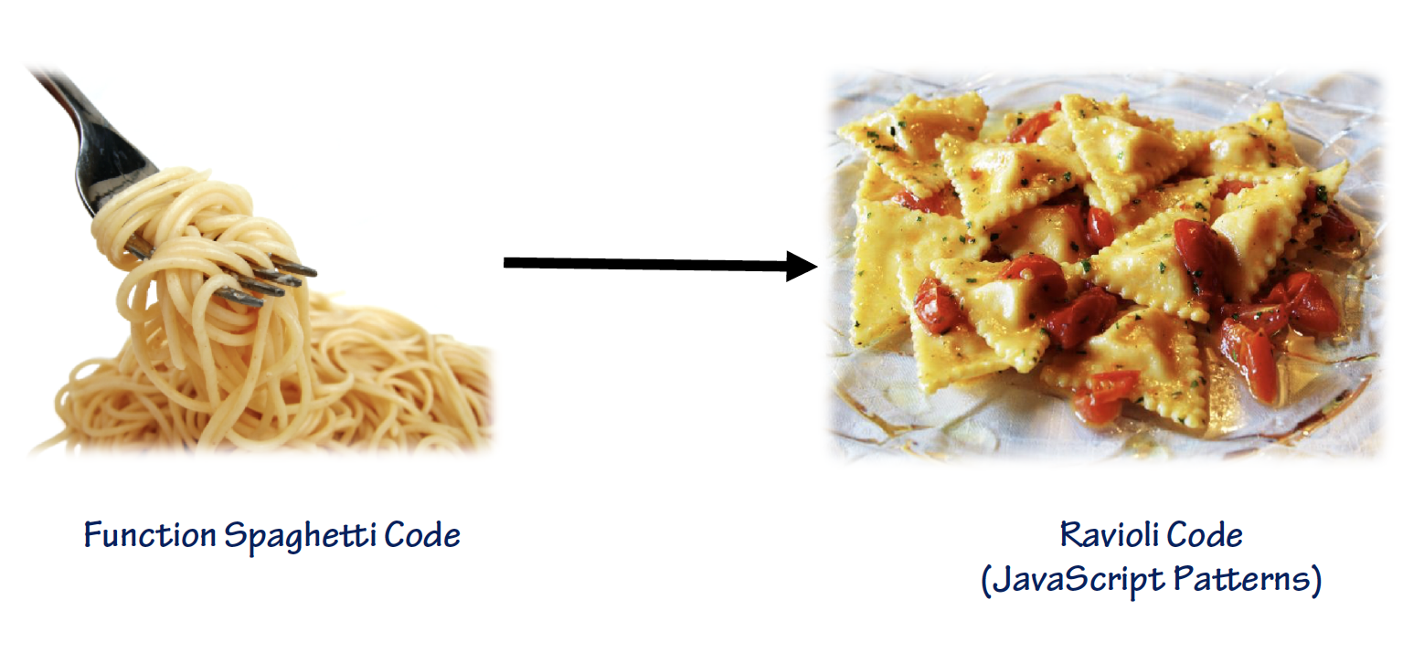
Why use TypeScript
  JavaScript Code Encapsulation:

Slide 4
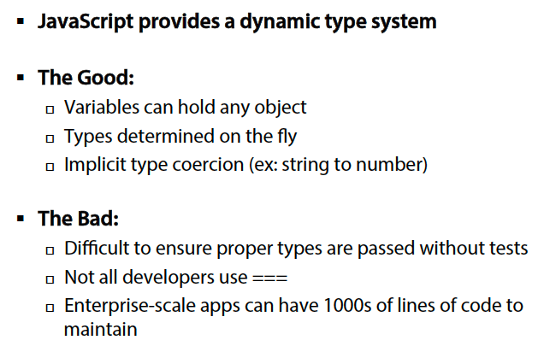
Why use TypeScript
  JavaScript Dynamic Types

Slide 5
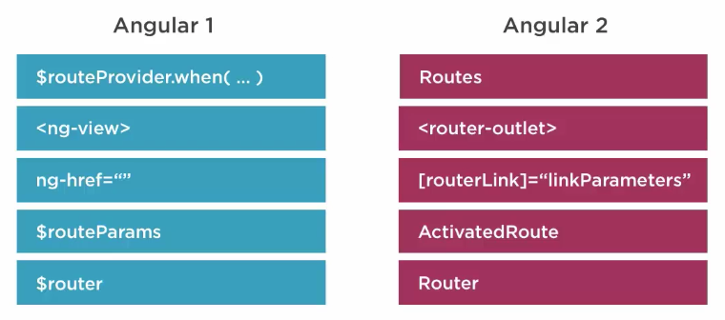
Defining Routes
  Routing then and now:

Slide 6
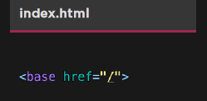
Defining Routes
  Define the <base> element:
  Required for routing to work properly

Slide 7
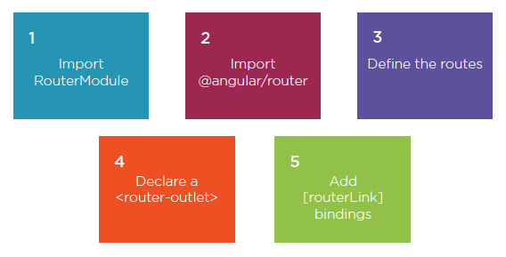
Defining Routes
  Routing Step by Step:

Slide 8
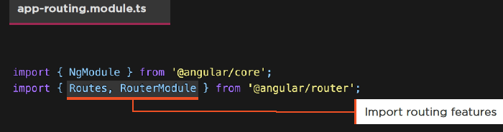
Routing Modules
  Import RouterModule:
  RouterModule gives us access to routing features
  Routes help us declare or route definitions

Slide 9
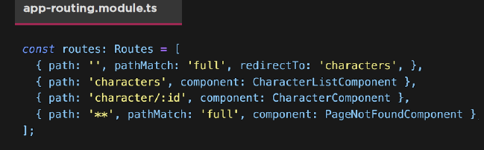
Routing Modules
  Defining Routes:
  Define the route’s path
  Indicate parameters with: Set the component that we’ll route to

Slide 10
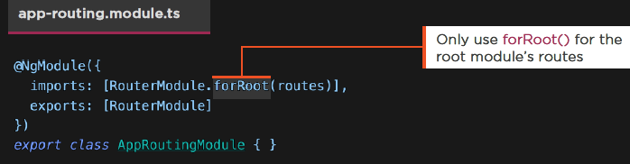
Routing Modules
  Defining a Module:
  Create a routing module using our routes, and import it
  Export our new AppRoutingModule

Slide 11
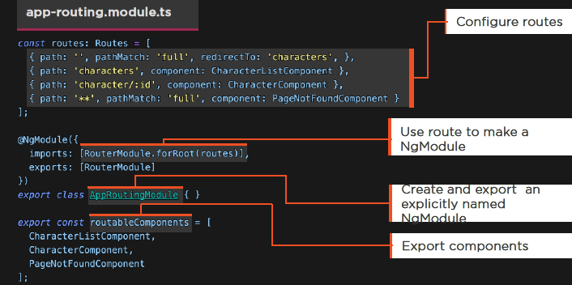
Routing Modules
  Export the Module and the Components

Slide 12
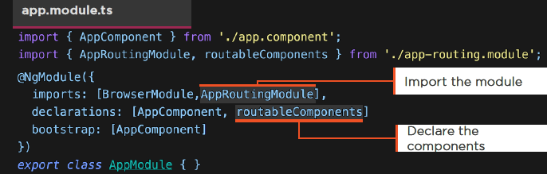
Routing Modules
  Using Our Routing Module:
  Import our routing module
  Declare the components

Slide 13
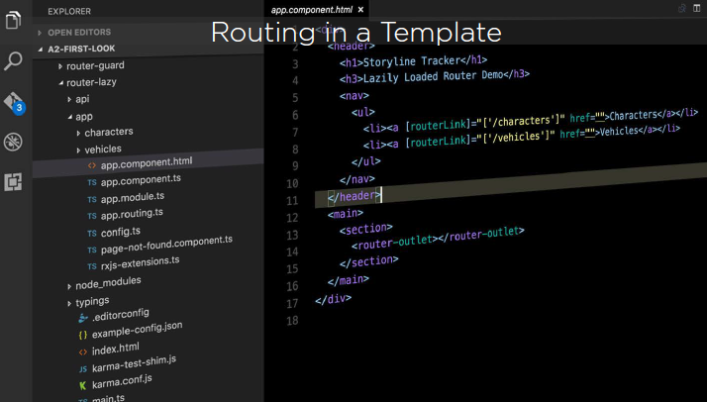
Routing Modules
  Routing in a Template:

Slide 14
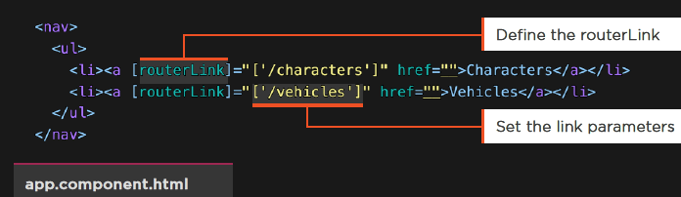
Routing Modules
  RouterLink:
  The RouterLink directive navigates to a route path
  We define the link parameters array

Slide 15
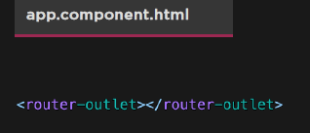
Routing Modules
  Using the RouterOutlet:
  Defines where to put the components when we route
  Demo: Need Router
  Demo: Router

Slide 16
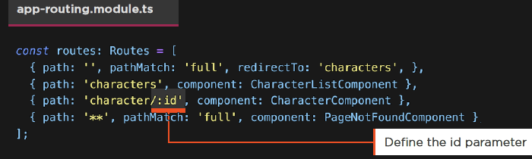
Route Parameters
  Defining Parameters:
  Indicate parameters with :id

Slide 17
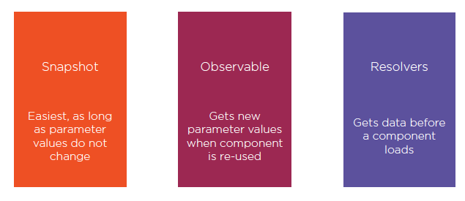
Route Parameters
  Passing Data Through Routing:

Slide 18
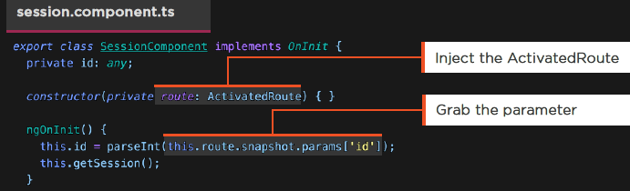
Route Parameters
  Snapshots:
  Grab the ActivatedRoute
  Access the snapshot parameter by name
  Easiest, if component is not reused

Slide 19
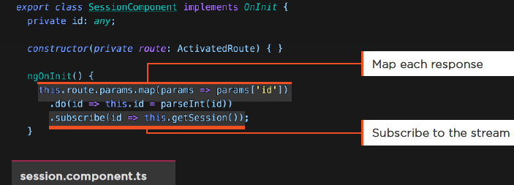
Route Parameters
  ActivatedRoute and Observables:
  Route.params is an Observable
  Map the response, perform side effects, and subscribe
  Demo: Router

Slide 20
Routing Resolvers
  Resolvers:
  Get data prior to traversing the route

Slide 21
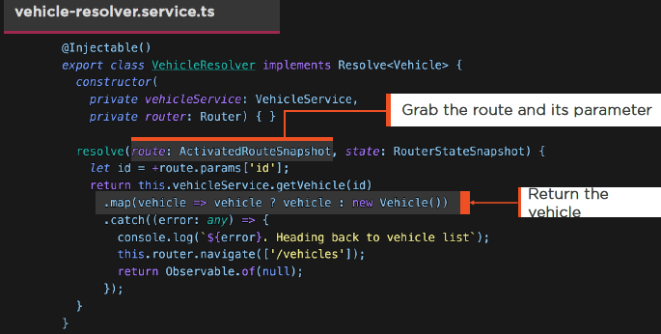
Routing Resolvers
  Service that operates in the midst of a routing action

Slide 22
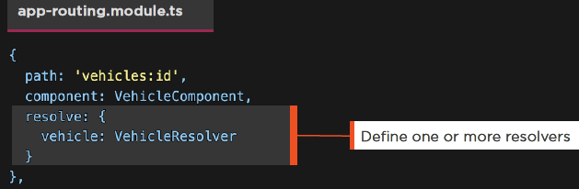
Routing Resolvers
  Resolvers:
  Defined within the route configuration
  Remember to provide the resolver service
  Demo: HTTP with Async Pipe

Slide 23
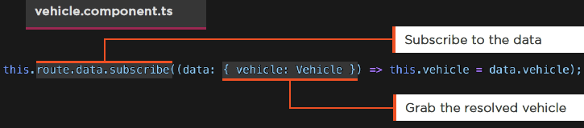
Routing Resolvers
  Getting Resolver Data:
  Subscribe to the data property on the ActivatedRoute

Slide 24
Routing Guards
  Guards:
  Guards allow us to make a decision at key points in the routing lifecycle and either continue, abort or take a new direction

Slide 25
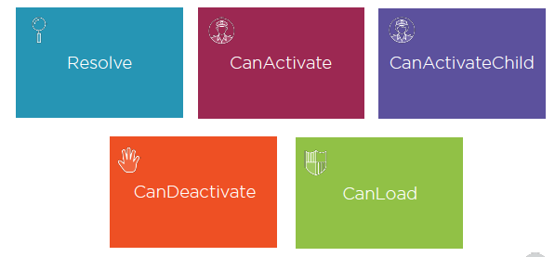
Routing Guards
  Types of Router Guards:

Slide 26
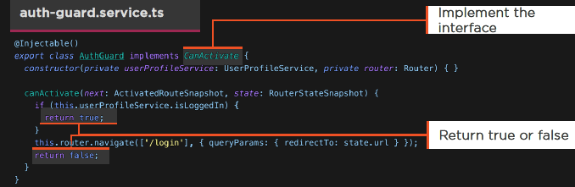
Routing Guards
  CanActivate Guard:
  Implement the CanActivate interface
  Make a determination if the route should be activated
  Can re-navigate elsewhere

Slide 27
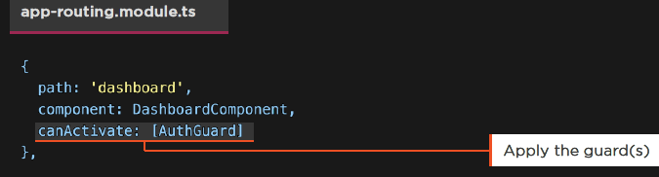
Routing Guards
  Applying a Guard:
  Apply to the route
  Demo: Routing Guards

Slide 28
Child Routes
  A Component may define routes for other Components.
  This creates a series of hierarchical child routes.

Slide 29
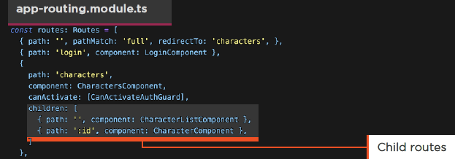
Child Routes
  Child Routes:
  URLs for parent child
  e.g. characters/ and characters/72

Slide 30
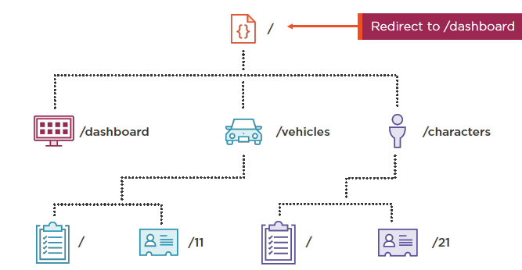
Child Routes

Slide 31
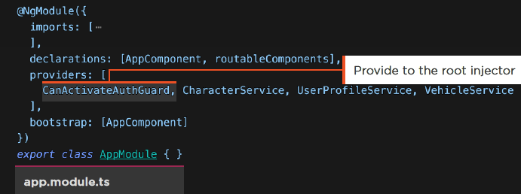
Child Routes
  Module Providers:
  Provided to the root injector
  Available everywhere

Slide 32
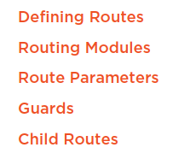
Summary

